Slide 1
Introduction and Research Topic
Poopha Suwananek
Supervisor
Prof. Min Suk Kang
Summer Research Internship
KAIST

Slide 2
Introduction
Poopha Suwananek: 3rd Year Computer Engineering Student at Chula-longkorn University
Supervisor: Prof. Min Suk Kang
Lab: Network Security and Privacy
Summer Research Internship
KAIST

Slide 3
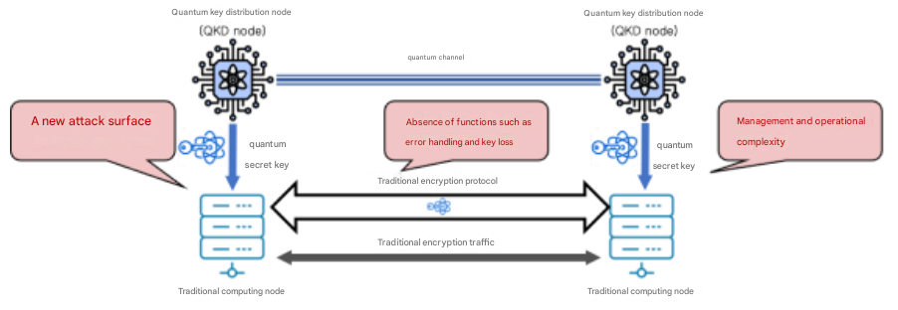
Research Topic
The incoporation of Quantum Key Distribution (QKD) within TLS

Slide 4
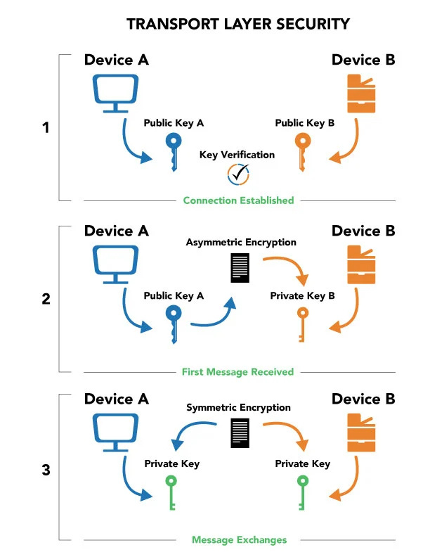
Transport Layer Security (TLS)

Slide 5
Transport Layer Security (TLS)
RSA

Slide 6
Transport Layer Security (TLS)

Slide 7
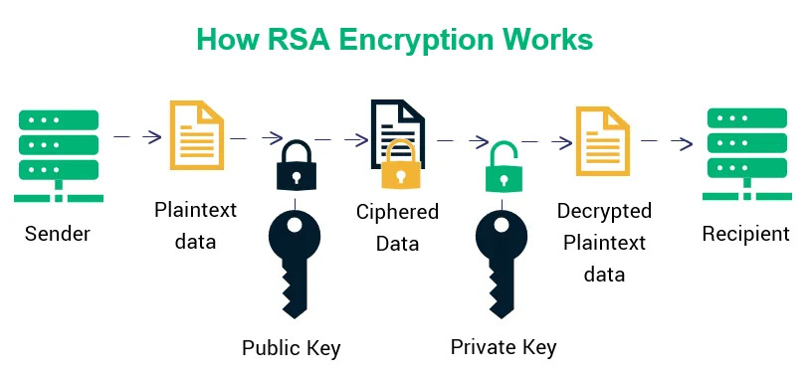
RSA Asymetric Encryption
Can theoretically be broken by Shor’s Algorithm

Slide 8
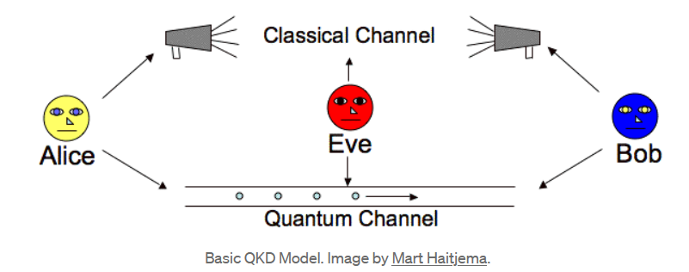
QKD

Slide 9
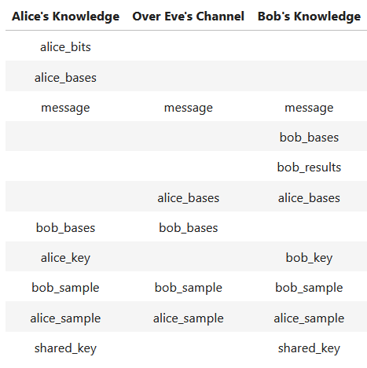
QKD
1000101011010100
HHXHXXXHXHXXXXXX

Slide 10
QKD
1000101011010100
HHXHXXXHXHXXXXXX

Slide 11
QKD

Slide 12
QKD
XHHHXHXHXHXHHHXH
1000101011010100

Slide 13
QKD
XHHHXHXHXHXHHHXH
1000101011010100

Slide 14
QKD
HHXHXXXHXHXXXXXX
XHHHXHXHXHXHHHXH
1000101011010100
HHXHXXXHXHXXXXXX
XHHHXHXHXHXHHHXH

Slide 15
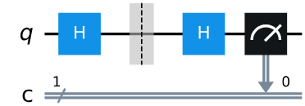
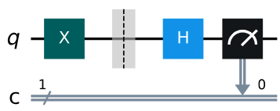
QKD
1
=
1
50%: 0
50%: 1
1
=

Slide 16
QKD
Alice and Bob kept only the key bits that has the same Basis
HHXHXXXHXHXXXXXX
XHHHXHXHXHXHHHXH
HHXHXXXHXHXXXXXX

Slide 17
Goal Of The Project
QKD can prevent eavesdropping of the key via the “no cloning theorem”
But it still has other disadvantages such as a man in the middle attack
That’s why it’s needed to be incorporated within TLS (Authentication, Key management, etc.)

